Slide 1
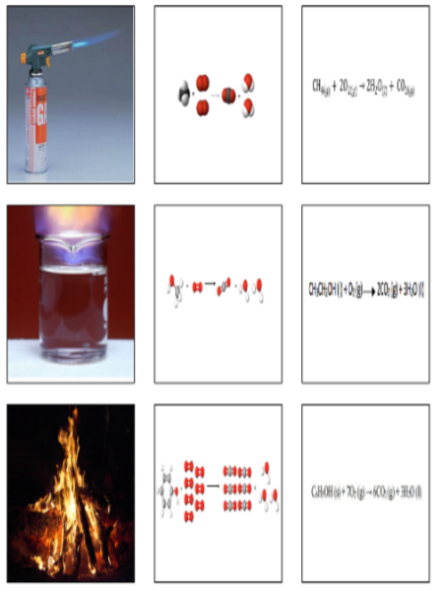
Surface:
ADG
BEH
CFI
Meaningful:
ABC
DEF
GHI
A
B
C
D
E
F
G
H
I

Slide 2
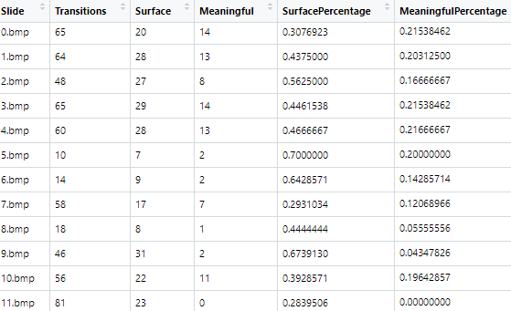
13 Students and 7 Professors

Slide 3
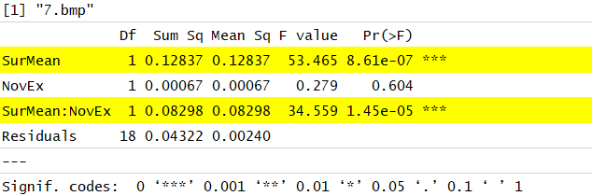
Two-Way ANOVA with Interactions
Students who made “Surface” connections vs
Professors who made “Meaningful” connections
SurMean really only shows that there is a difference between the percentage of surface and conceptual
transitions, this makes sense and does not provide interesting analysis, so instead turn to SurMean:NovEx,
which is the interactions between the groupings.

Slide 4
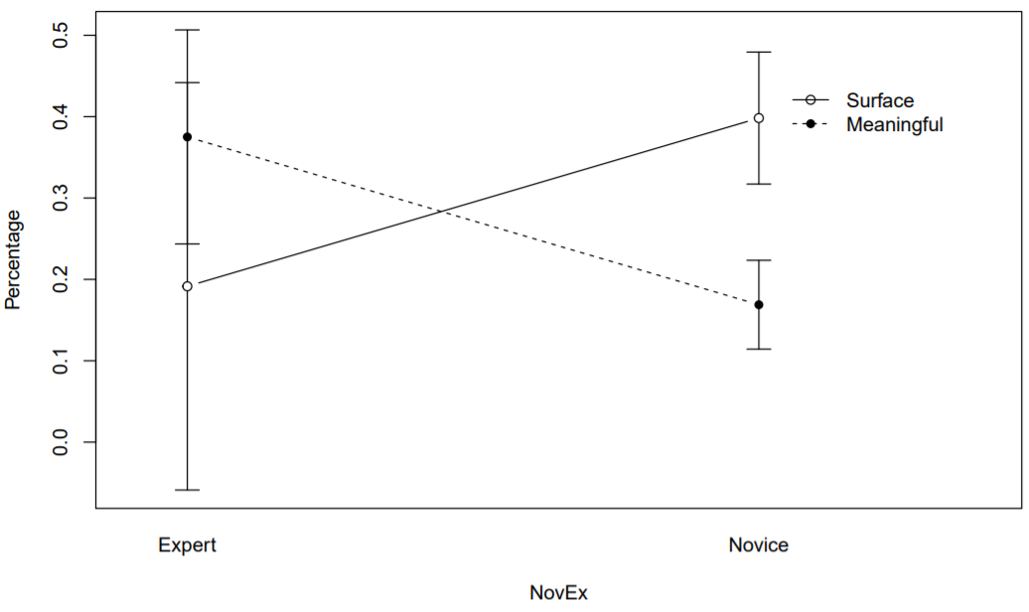
Slide 4

Slide 5
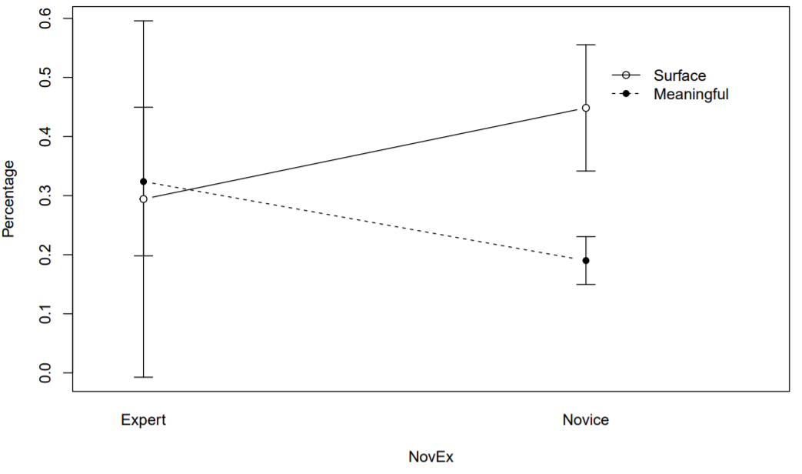
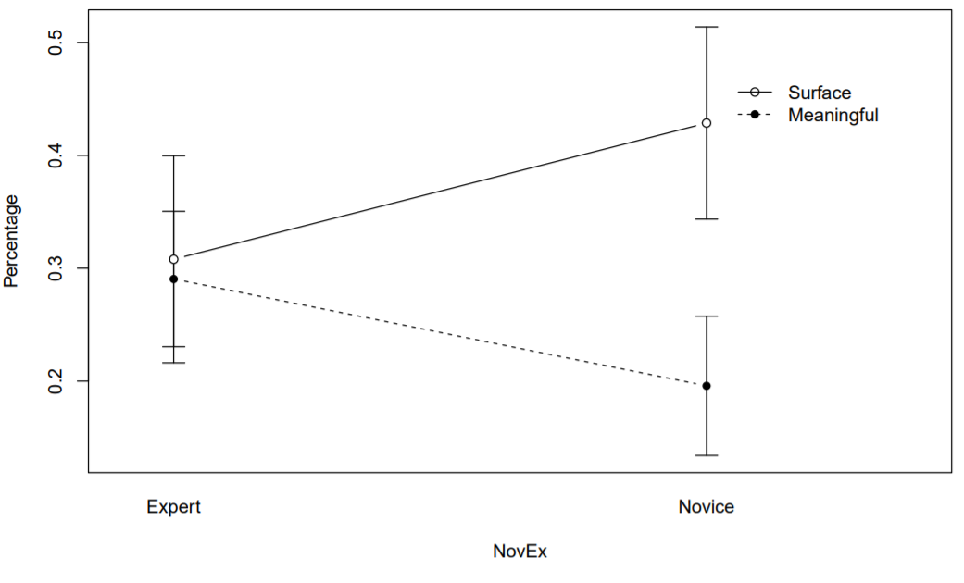
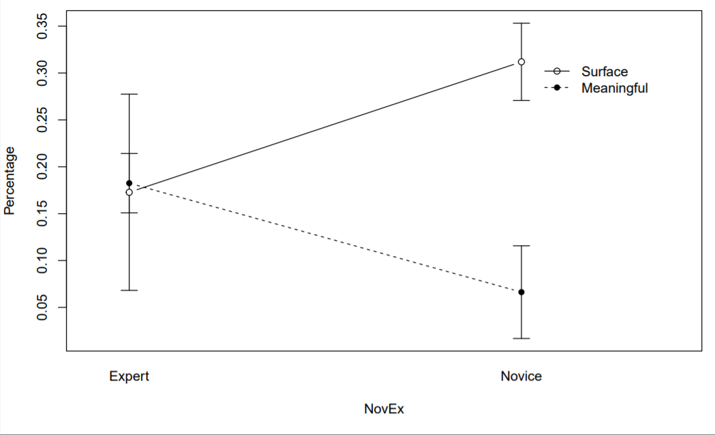
Slide 5
Slide 6
Slide 7

Slide 6
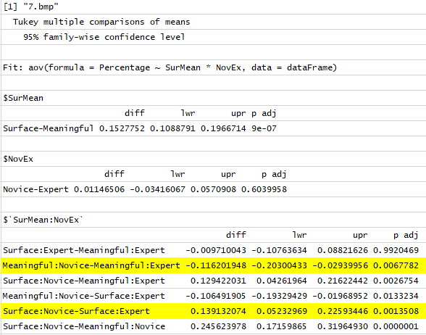
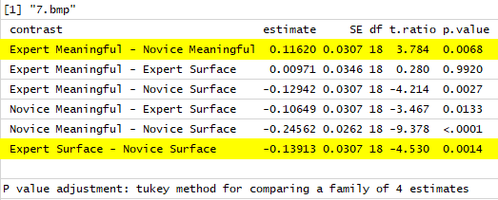
Null Hypotheses:
Students make the same percentage of conceptual transitions as experts
Students make the same percentage of surface transitions as experts

Slide 7
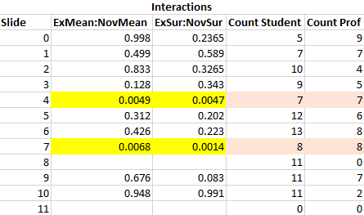
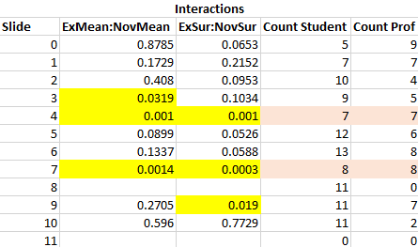
P-Values with Tukey Adjustment
P-Values Without Adjustment

Slide 8
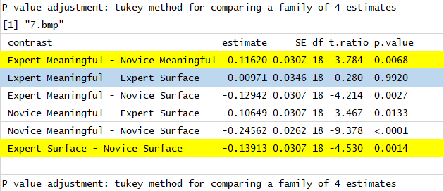
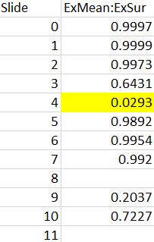
Null Hypothesis:
The amount of conceptual transitions that a professor makes has no impact on the amount of surface transitions

Slide 9
Surface:
ADG
BEH
CFI
Meaningful:
ABC
DEF
GHI
A
B
C
72 possible transitions (9 starting spots and 8 transitions from that start)
9 surface transitions (A-D, A-G, C-F, etc.)
9 meaningful transitions (A-B, F-D, etc.)
D
E
F
Expected distribution if random transitions:
Meaningful: 12.5%
Surface: 12.5%
Invalid: 75%
G
H
I

Slide 10
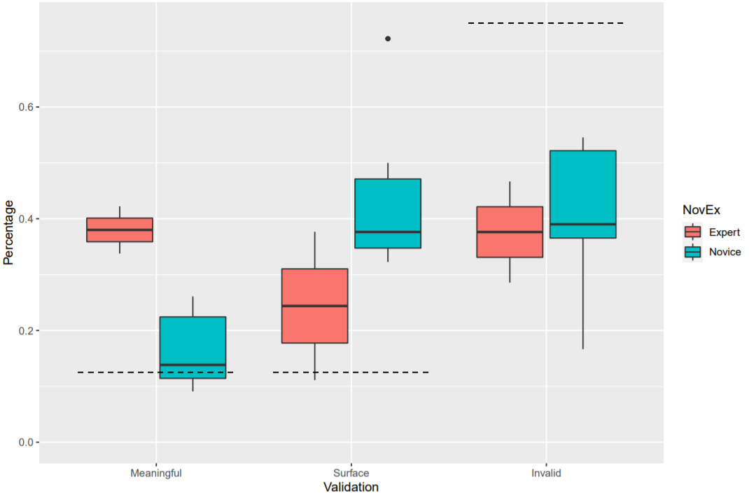
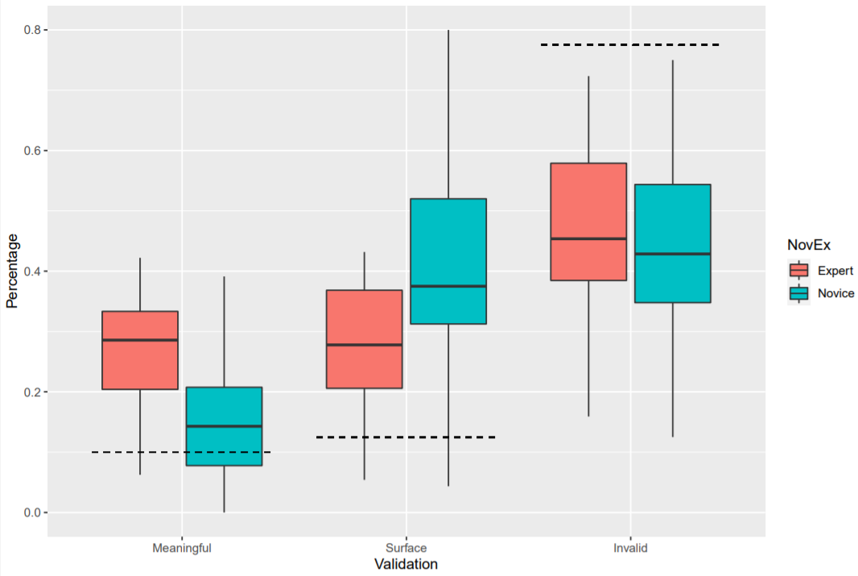
Slide 3
Total

Slide 11
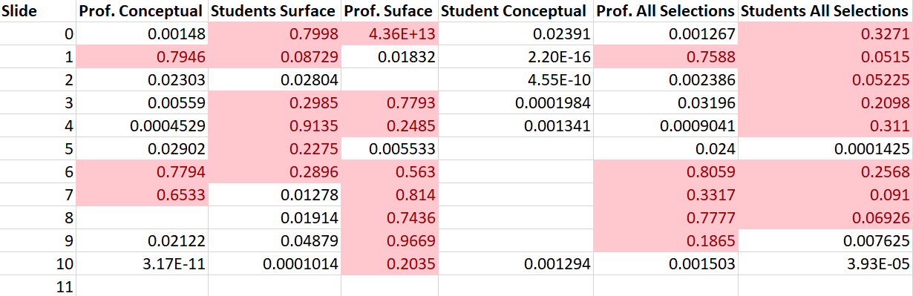
Chi-Squared Tests (P-Values)
Null Hypothesis:
The group is behaving as if random transitions were occurring
Note: Student conceptual may be misleading due to small sample size

Slide 12
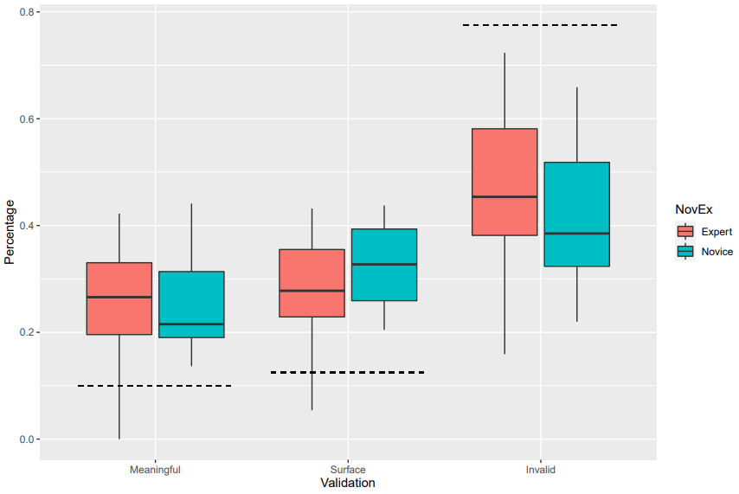
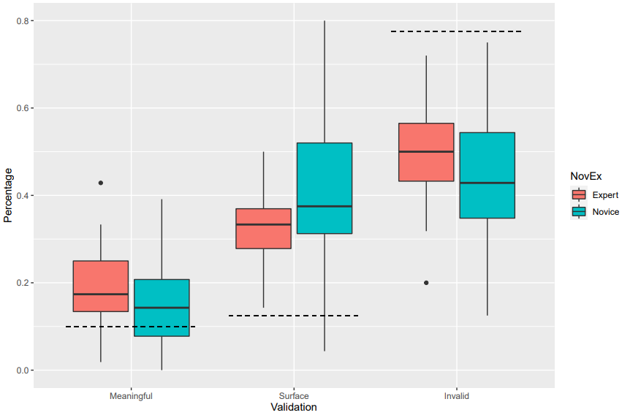
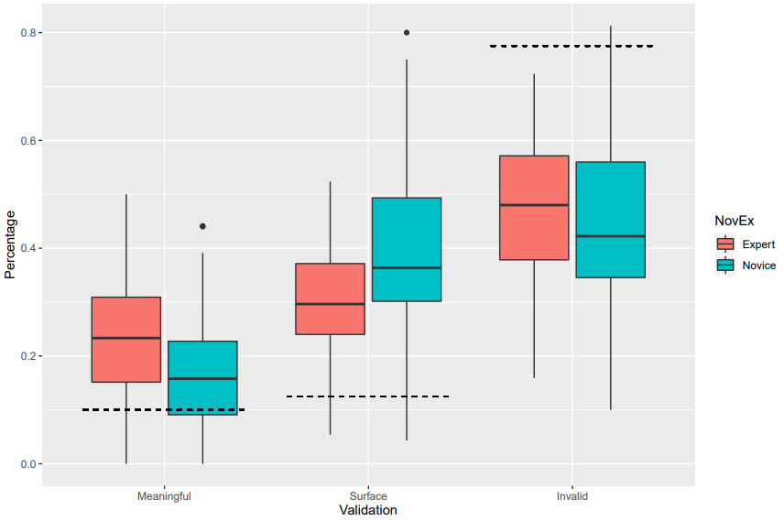
Prof. Conceptual – Student Surface
Prof. Conceptual – Student Conceptual
Prof. Surface – Student Surface
Prof. All – Student All

Slide 13
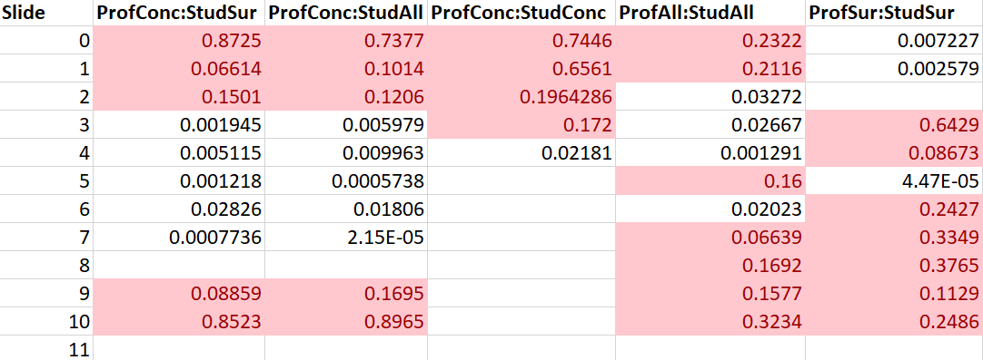
T-Test of Meaningful Transitions (P-Values)
Null Hypothesis:
Each group has an equal number meaningful transitions
Note: ProfSur and StudConc may be misleading due to small sample sizes

